Slide 1

Application Controller Pattern
Zanele Hlongwane

Slide 2

Problem
The problem addresses by the application control pattern is when you want to centralize and modularize action and view management.

Slide 3

In Java EE 8 Design Patterns and Best Practices, they explain that:
Some web applications have a complex logic for defining the correct view, content, or action to invoke. The MVC controller can be used to make this decision and get the correct view, content, or action. However, sometimes the logic to define a decision is very hard, and using the MVC controller to do this can cause duplication of a lot of code. To solve this, we need to centralize the logic at one point to permit an easy maintenance and a central logic point.
The application controller pattern is the pattern that permits the centralization of all view logic and promotes a unique process to define the flow of pages. (Rocha & Purificacao)

Slide 4
What does this mean? I think it means that you can reuse action and management view code without having to duplicate your code.
According to Core J2EE Patterns, it means that:
You want to reuse action and view-management code.
You want to improve request-handling extensibility, such as adding use case functionality to an application incrementally.
You want to improve code modularity and maintainability, making it easier to extend the application and easier to test discrete parts of your request-handling code independent of a web container. (

Slide 5
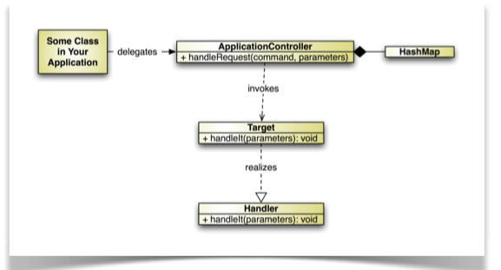
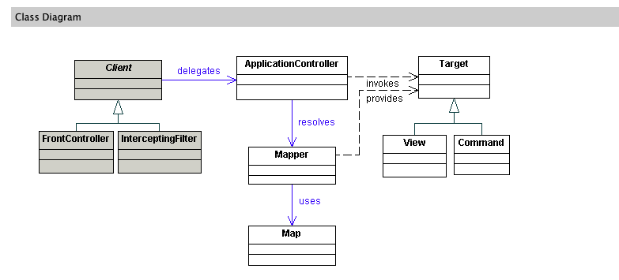
Application Control Pattern Diagram from Lee S. Barney’s Doing More with Java (p. 85)
Application Control Pattern Diagram from Core J2EE Patterns: Best Practices and Design Strategies (2nd Edition)

Slide 6

References
Rocha, Rhuan, Purificacao, Joao. Java EE 8 Design Patterns and Best Practices: Build enterprise-ready scalable applications with architectural design patterns. Accessed 2018.10.19 https://www.packtpub.com/mapt/book/application_development/9781788830621/2/ch02lvl1sec20/the-application-controller-pattern
Alur, Deepak. Core J2EE Patterns: Best Practices and Design Strategies (2nd Edition). Accessed 2018.10.19, http://www.corej2eepatterns.com/ApplicationController.htm
Barney, Lee S. Doing More with Java,

